Slide 1

(TIME TO) BEHAVE AND REACT RIOT
LESSON 6
CFGDEGREE → FULL-STACK STREAM

Slide 2

AGENDA
01 What is behaviour
02 Adding behavioural mechanisms to components
03 Sharing data between components via props

Slide 3

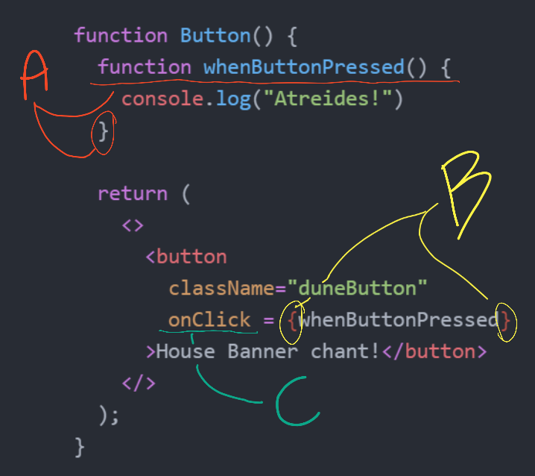
Walkthrough: What is behaviour?
And how does it relates to components?
# AFTER THE LEFT-HAND SIDE, YOUR INSTRUCTOR WILL EXPLAIN A, B, C AND THEIR PURPOSE
It effectively is what we learnt during our JavaScript course - we simply write a set of instructions that the component must follow depending on the event
For example, we can create a onClick function and assign it to the button component
Once assigned, we can tell the component that every time it’s clicked, it must follow whatever is within onClick
A primary difference to JS is that these ‘behavioural’ functions are normally stored within the component file as well - effectively centralising a lot of code together (the component file is already .js!)

Slide 4
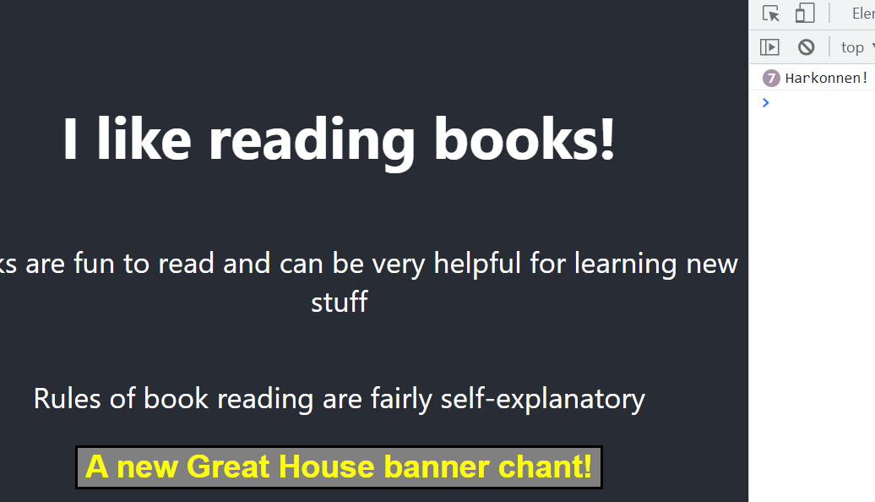

Exercise 1: Adding a onClick for React
Time to do it on your end (if not done)
# EXAMPLE OUTPUT
Similar to the example before, ensure that your button outputs some sort of a message when pressed!
Learning from the previous slide, you’ll need to add the correct property/s and design a correct mechanism
You have approx. 8 minutes for this (depending on your instructor's discretion + current time!). Google when you can!

Slide 5
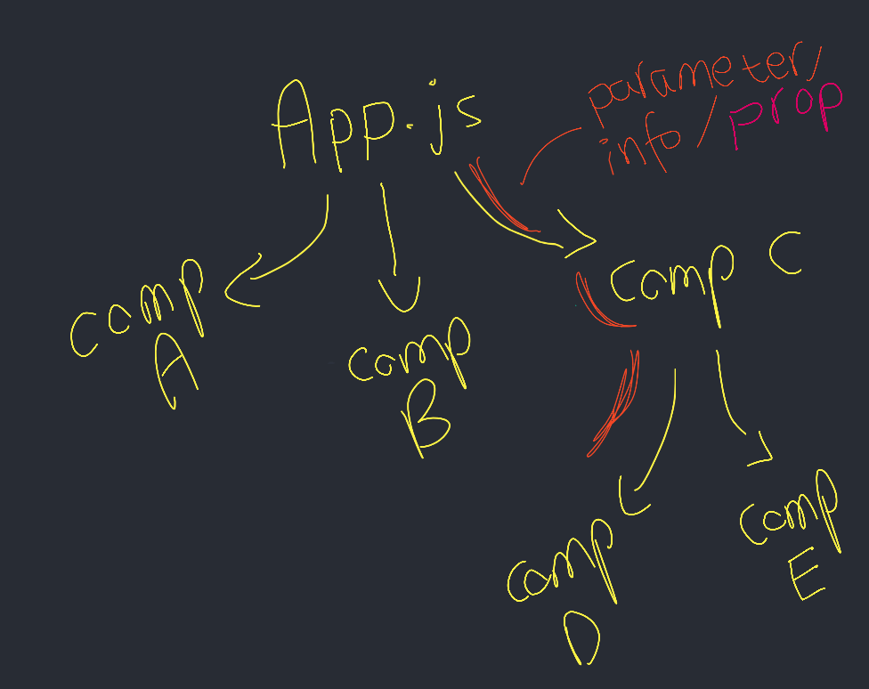
Walkthrough: Passing information via props
Make the button customisable instead of hard-coding stuff!
Components can pass pieces of information to each other - called props
It’s extremely similar to how we call functions in Python and pass values to them for use
We can pass anything, and assign any ID / property name to the lower component - for example:
nameDoesNotMatter = “Prop ‘nameDoesNotMatter’ value”
Note that all components receive a prop object anyway! Adding values to it in the parent component above just means that the object actually has a propNameID : propValue this time

Slide 6
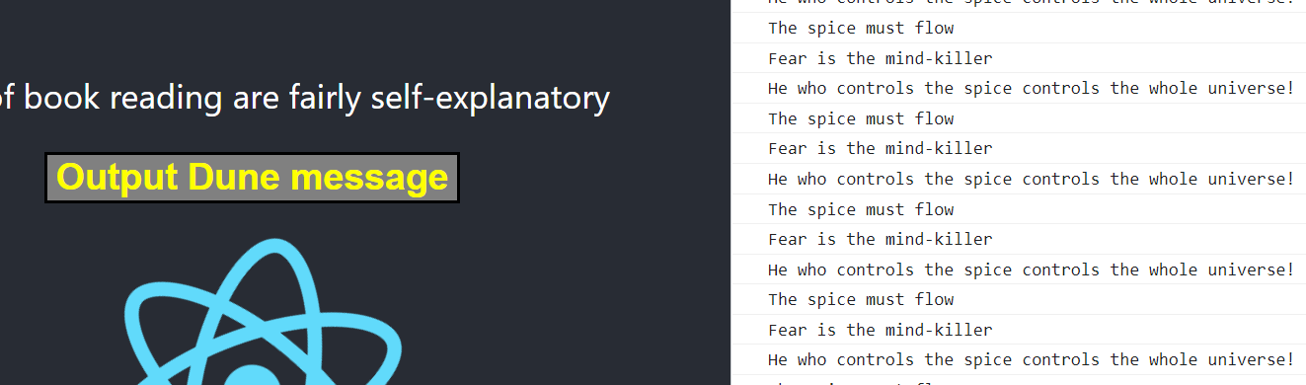
Exercise 2: Adding props to your button
For the next 15 minutes, add a prop to your button that changes its button text
What if in the future, I wanted to change the button text? It’d be easy to modify everything in one central place (e.g. App.js) with the information being passed down appropriately (prop all the way down to button)
For this exercise, ensure that you have the ability to change your button text from App.js. Make sure you modify the onClick to randomly output a message of your choosing (per click!) - repeating is fine though
# EXAMPLE OUTPUT

Slide 7
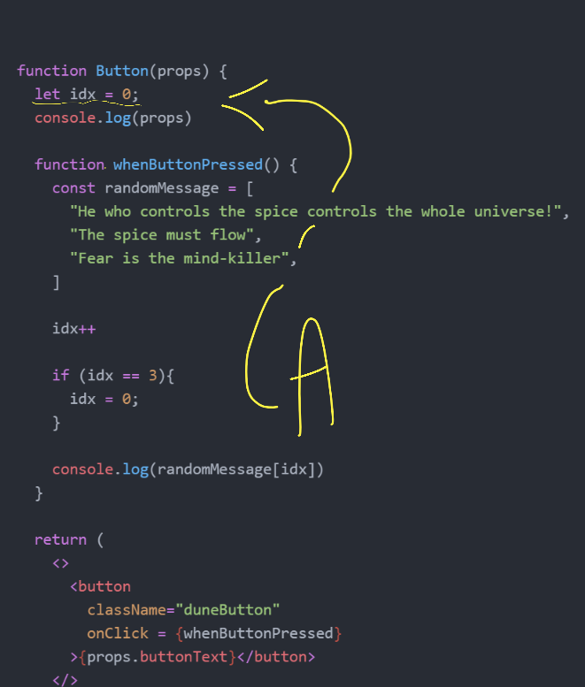
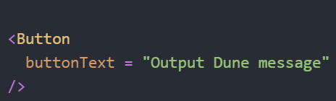
Exercise 2 Solution: What it can look like
This is one of many options though - all are equally valid! Your instructor can explain A and the code
# EXHIBIT B
# EXHIBIT A
In App.js, a new prop identifier can be added to the component (or wherever else you’ve placed <Button />
Inside the Button component, props (which is always extracted, even if it's not inside the brackets) can be unpacked and referred to - as its an object, using the dot notation to access buttonText is all that’s needed
The {} are used in order to not make JSX complain / ensure it doesn’t think this is just some random word

Slide 8
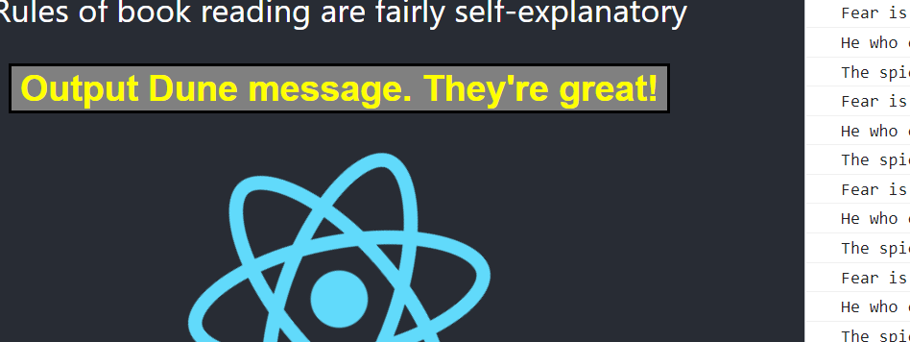
Exercise 3: Add multiple props!
Think back to how you did it for just one - it’s incredibly similar!
Editing your button component, now change its text (one inside the button) to be the combined version of two separate props
Essentially pass two (or more) props in and append their text together
# EXAMPLE OUTPUT
You have approx. 5 minutes for this (depending on your instructor's discretion + current time!). Google when you can!

Slide 9
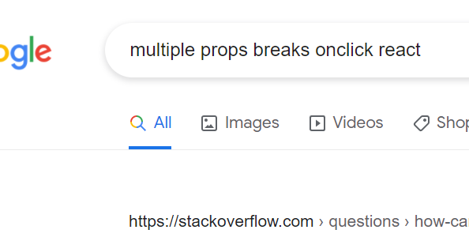
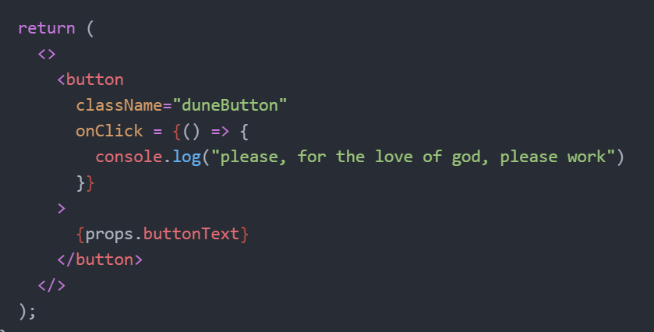
SUMMARY
Components can be customised both in their appearance as well as their behaviour
Information can be shared between components via props - data that’s passed linearly (usually downwards) in a hierarchical system
As an aside, always make sure to keep googling! In the creation of these slides, there was a lot of frustration dealing with props. Always make sure to make plenty of use of Google + React docs

Slide 10
THANK YOU!

